Slide 1
2018 2nd qtr RHOA newsletter
Traveling anytime, and need an extra set of eyes watching your home. Where can I get a vacation or security check you may ask? Bartlett Police department; http://bartlett.onlinegovt.com/
-Click Submit Citizen Request and follow the prompts.
RHOA Annual Meeting was held May 8, 2018 @ Rivercrest Elementary School from 6 – 7:45pm. If you missed it and have not received the minutes from the meeting please email: rhoa38135@gmail.com with your contact information.
May 15, 2018 “Peace Officers Memorial Day”
President John F. Kennedy declared the first Peace Officers Memorial Day on May 15, 1962, as a tribute to peace officers and in honor of peace officers who, through their courageous deeds, lost their lives or became disabled in the line of duty. This day has been observed in our country annually ever since.
http://www.cityofbartlett.org/CivicAlerts.aspx?AID=1191
BARTLETT RANKS AMONG MOST AFFORDABLE PLACES TO LIVE IN TENNESSEE
http://www.cityofbartlett.org/CivicAlerts.aspx?AID=1186
Please visit our Ravencrest webpage ; http://ravencresthoa.org/
Ravencrest HOA Board Members (call for assistance)
-Marcus D. Johnson, RHOA President, 901.240.3821
-Alexander Elkins, RHOA Vice President, 901.713.2317
-Demetra Walton, RHOA Secretary, 901.485.3310
-Joan Biggs, RHOA Treasurer, 901.372.6096
-Elijah Bernard, RHOA Architect, 901.258.1858
-Darnell Reid, RHOA Member-At-Large, 901.481.5500
Upcoming Events:
-June 1, 2018: “RHOA YOM” (May Winners)
-June 16, 2018 (9am – 2pm): “Community Sale”

Slide 2
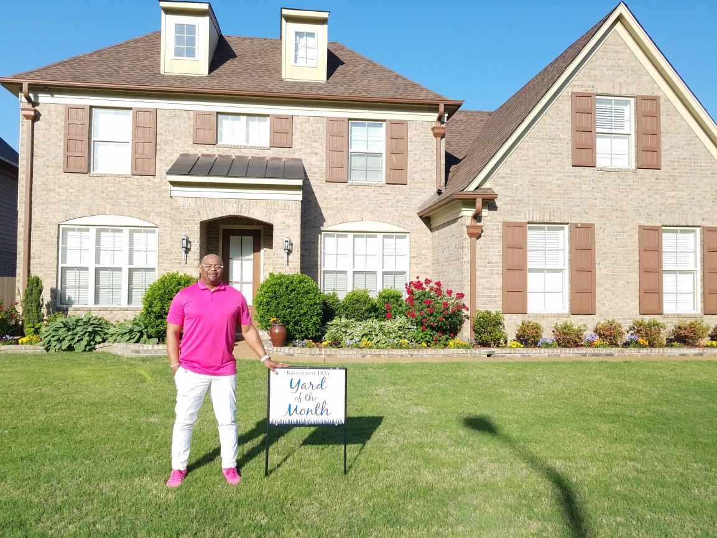
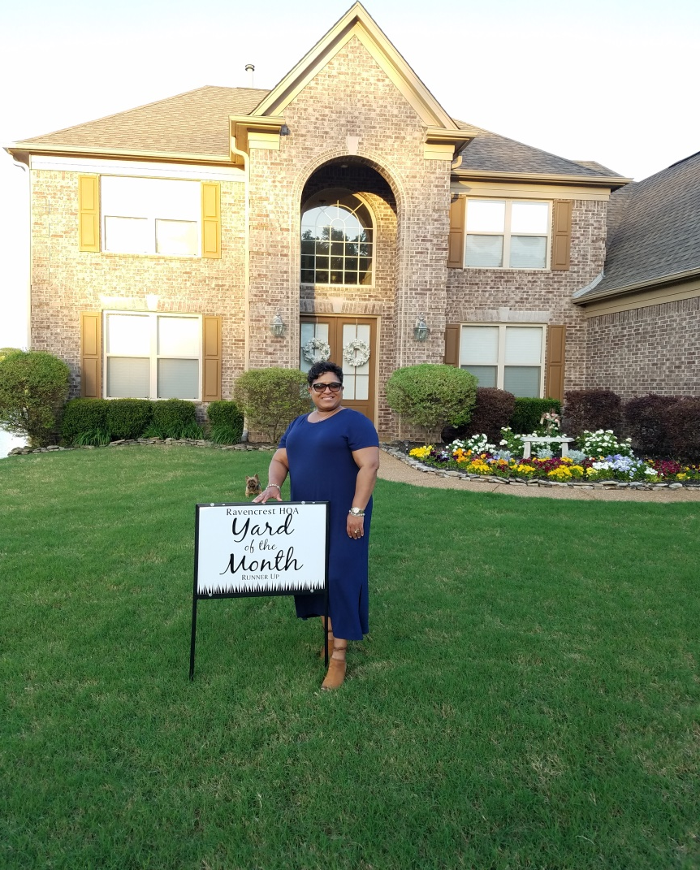
2018 2nd qtr RHOA newsletter
April 2018 YOM Winner
Russell Talley
April 2018 YOM Runner Up
Tonya & Vincent Beasley

Slide 3
2018 2nd qtr RHOA newsletter
Numbers to know:
BARTLETT POLICE
*Any non-emergency: 901-385-5555
*EMERGENCY: 9-1-1
*All Other Calls: 901-385-5500
BARTLETT FIRE
Terry Wiggins, Fire Chief & Tommy Gately, Asst Chief
2939 Altruria Road, Bartlett, TN 38134
901-385-5536
BARTLETT PARKS & RECREATION
Susan Scott, Administrative Clerk
5868 Stage Road, Bartlett, TN 38134
901-385-5590, http://www.cityofbartlett.org/1213/Bartlett-Information-Guide
Hours: Monday – Friday (8 a.m. - 5 p.m.)
In the city of Bartlett, “How Do I…?
http://www.cityofbartlett.org/7/How-Do-I
Resources:
What a great city we live in… Bartlett ranks in the Top 10 cities to live in Tennessee. http://www.cityofbartlett.org/CivicAlerts.aspx?AID=1149
Bartlet Express Weekly Newspaper
http://bartlett-express.com/
Bartlett Performing Arts & Conference Center
http://www.bpacc.org/
BARTLETT INFORMATION GUIDE
http://www.cityofbartlett.org/DocumentCenter/View/557/Current-City-of-Bartlett-Brochure
Bartlett Board of Mayor and Alderman
Mayor A. Keith McDonald, Vice Mayor Jack Young Alderman W.C. (Bubba) Pleasant, Alderman Emily Elliott, Alderman David Parsons, Alderman Bobby Simmons, Alderman Paula Sedgwick.
http://www.cityofbartlett.org/Faq.aspx?QID=263
To learn more about our great city of Bartlett, visit their website; http://www.cityofbartlett.org/Faq.aspx?QID=265

