Slide 1
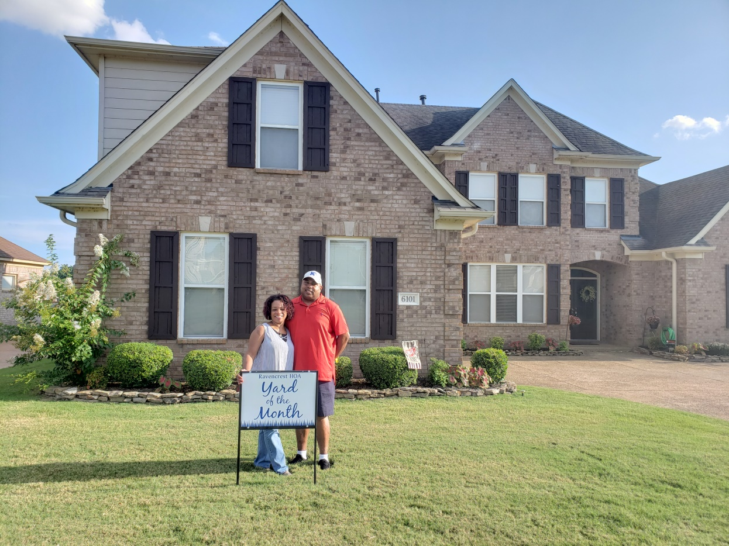
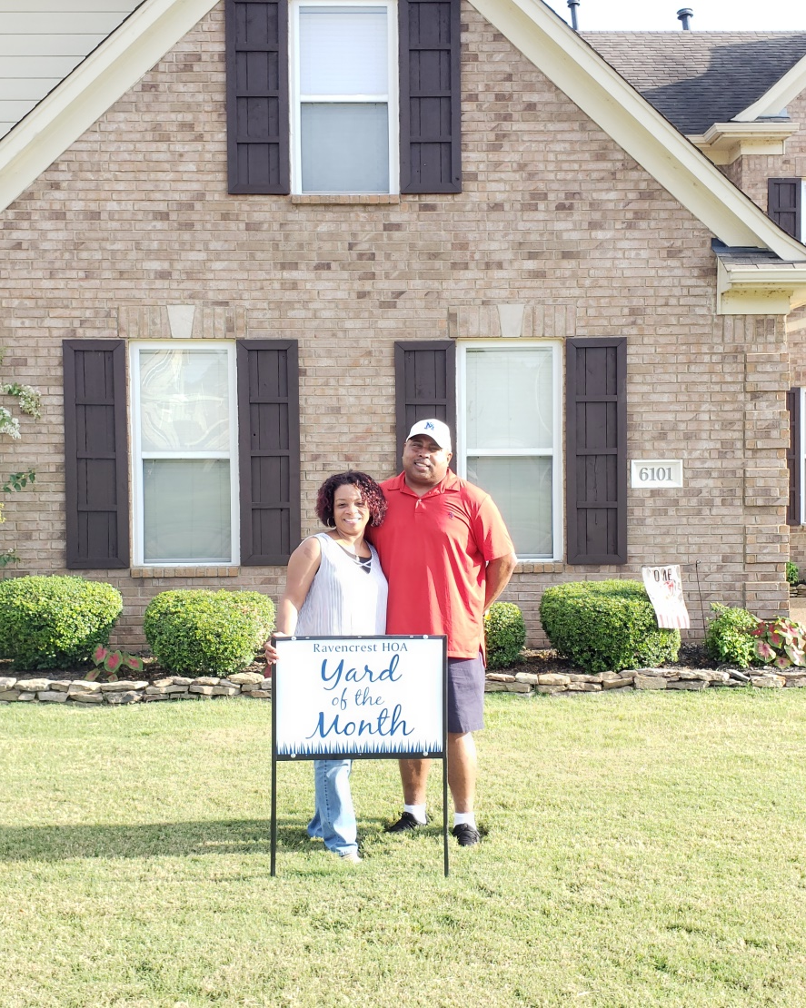
RHOA YOM Winners, August 2018!
YOM Winner:
Phyllis & Venson Whitmore
6101 Lamb Woods Dr.

Slide 2
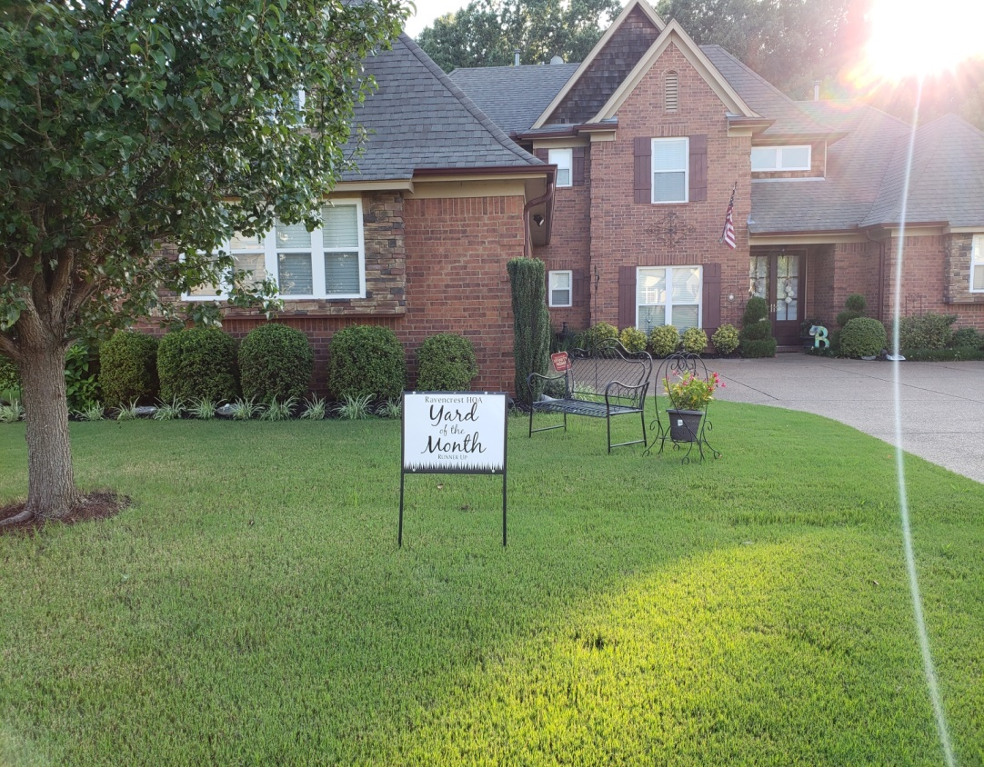
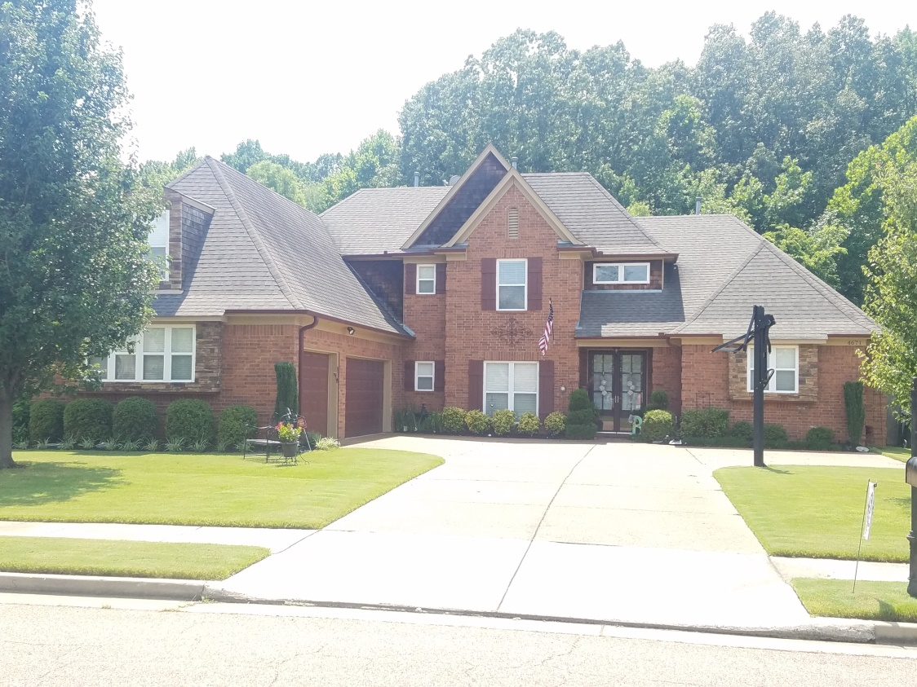
RHOA YOM Winners, August 2018!
YOM Runner Up:
Velma & Joe Baldelli
4671 Dylan Valley Dr.

