Slide 1
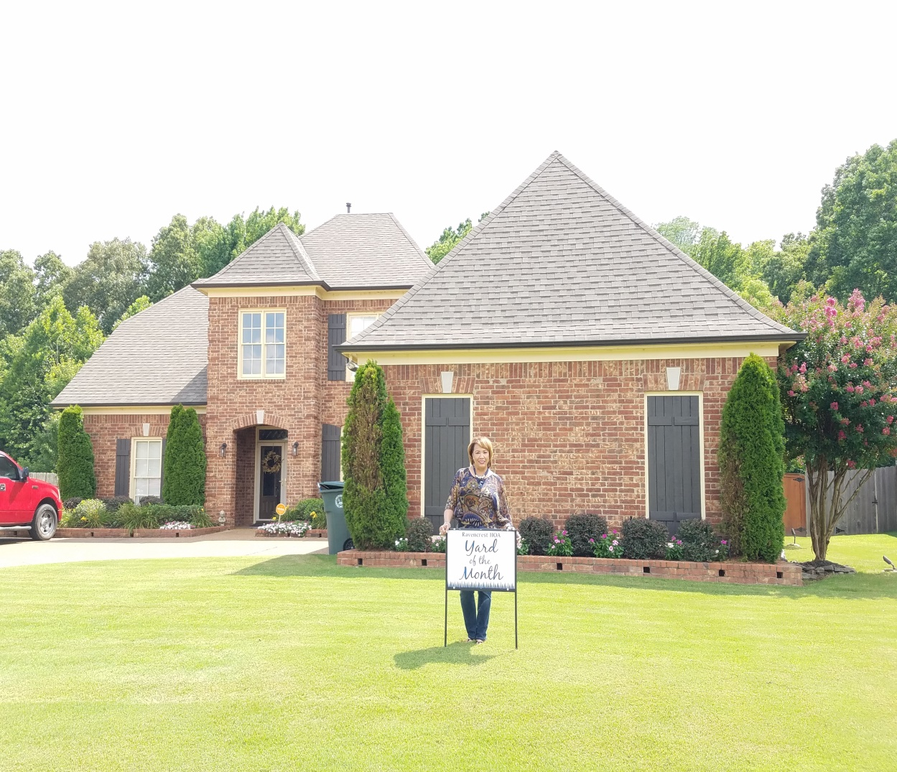
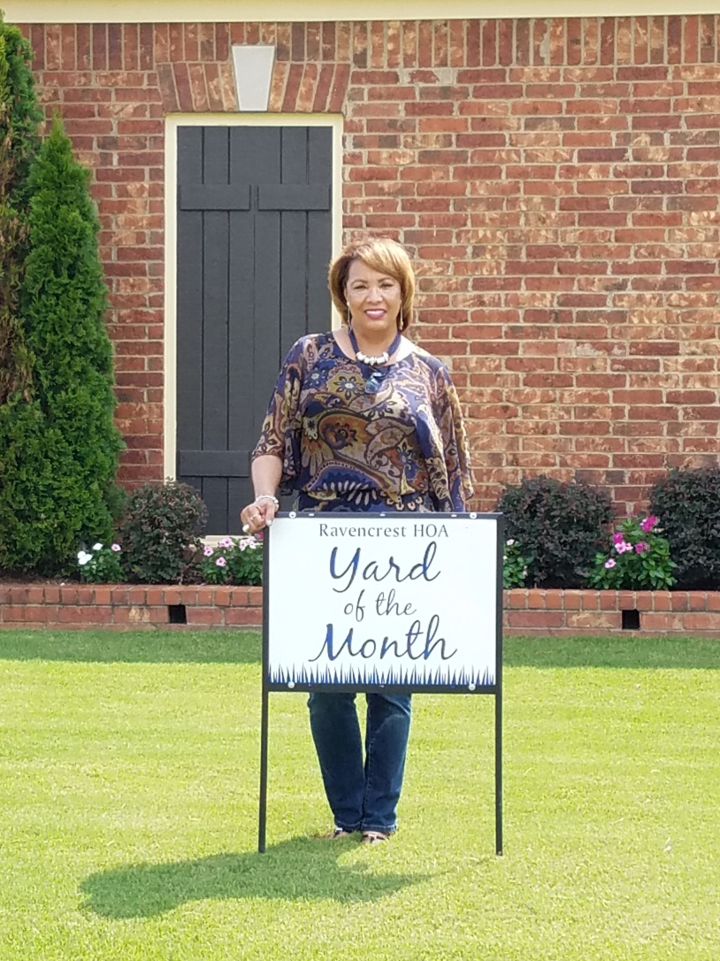
RHOA YOM Winners, July 2018!
4699 Dylan Valley Dr. YOM Winner:
Melba & David Fisher

Slide 2
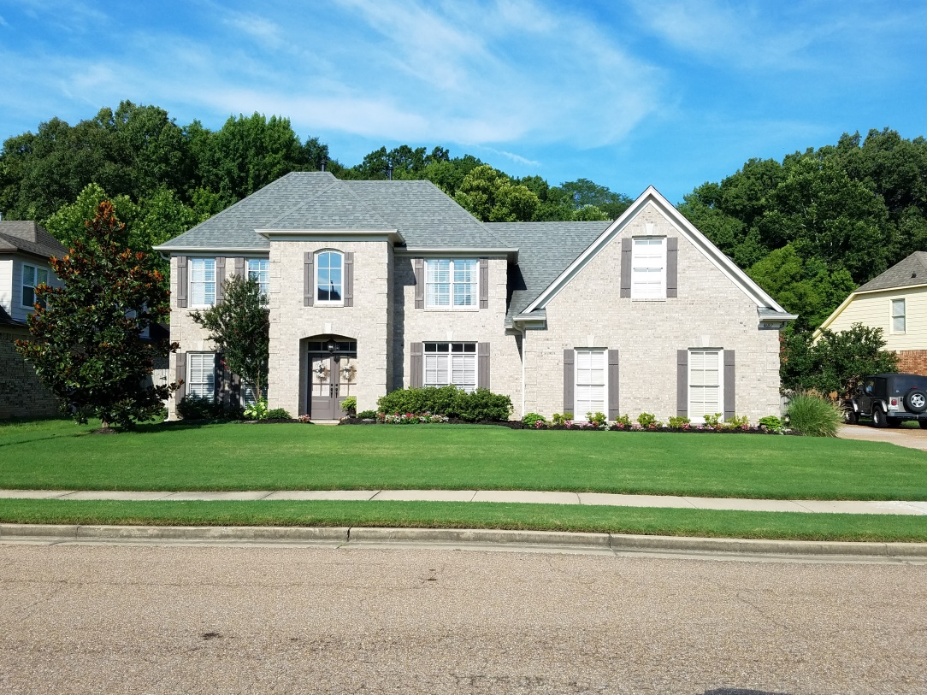
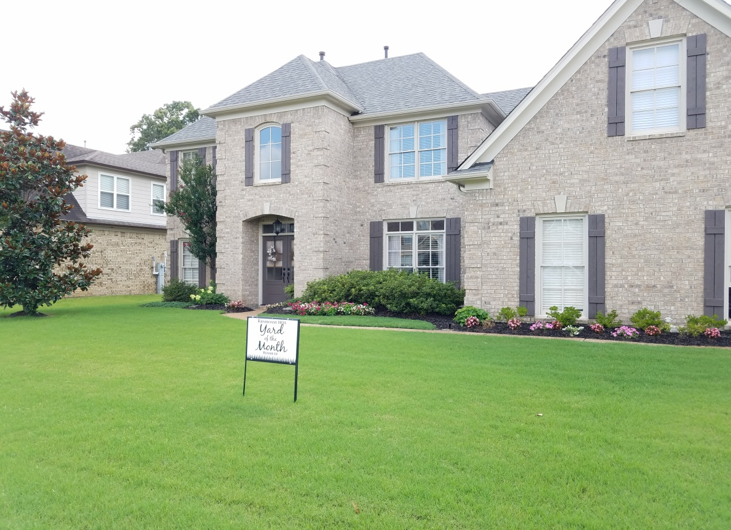
RHOA YOM Winners, July 2018!
YOM Runner Up:
Gene & Belinda Hubbard
4687 Dylan Valley Dr.

