Slide 1

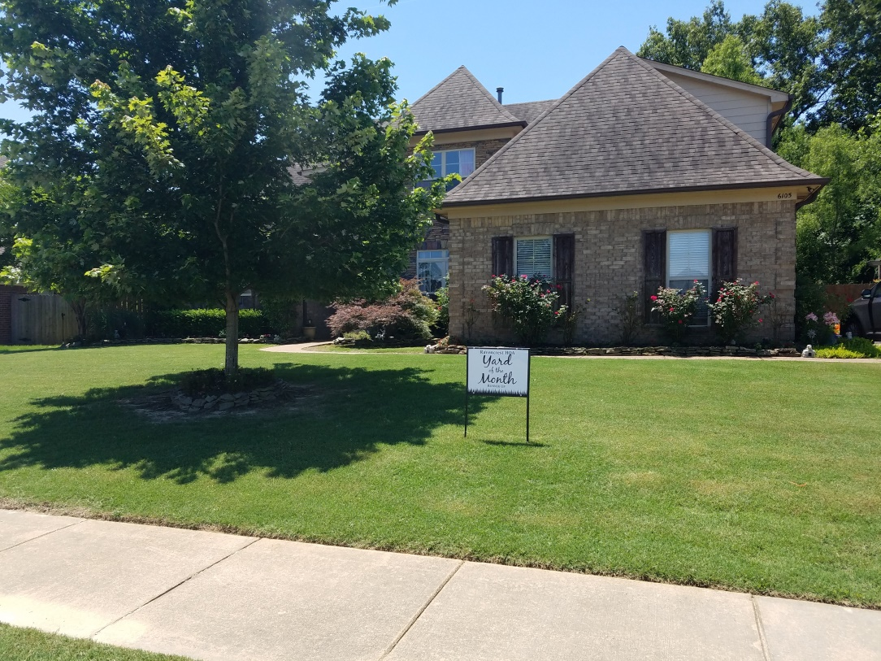
YOM Winners, June 2018!
YOM Winner
YOM Runner-Up

