Slide 1
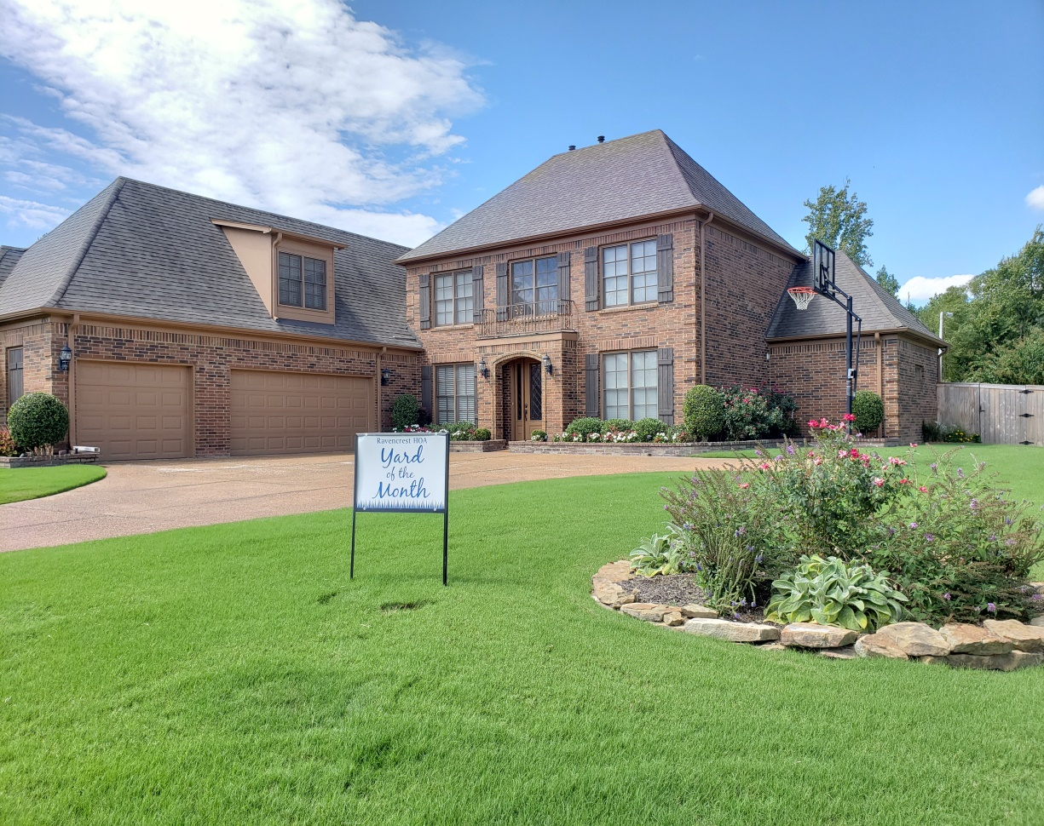
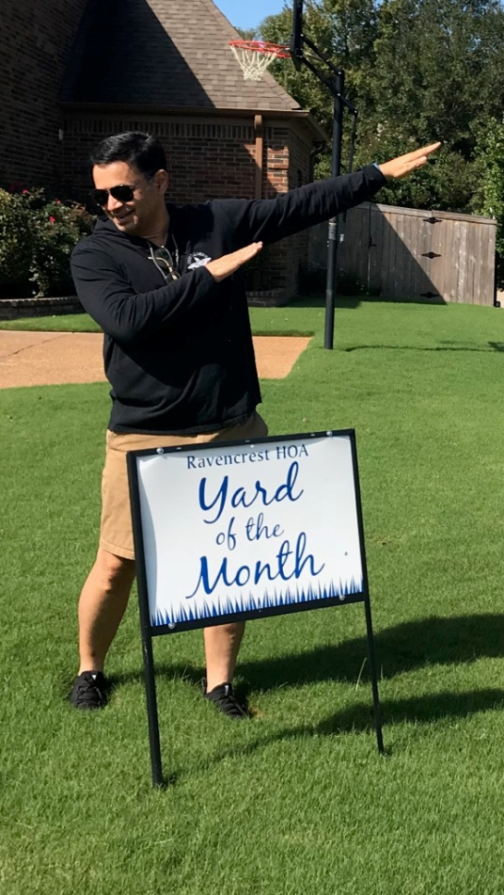
RHOA YOM Winners, September 2018!
YOM Winner:
Syed & Larissa Zaidi
4765 Dylan Valley Dr.

Slide 2
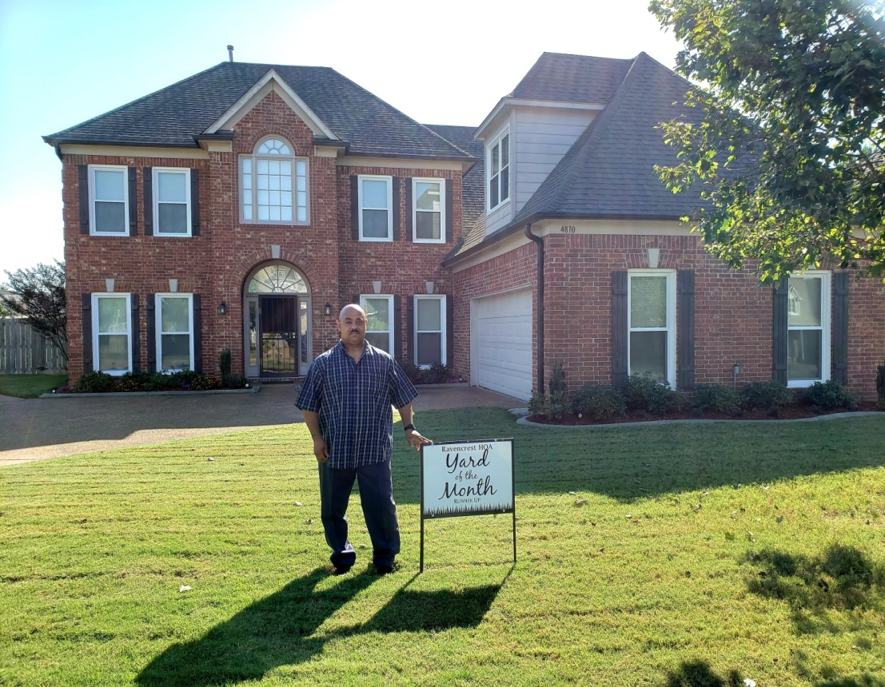
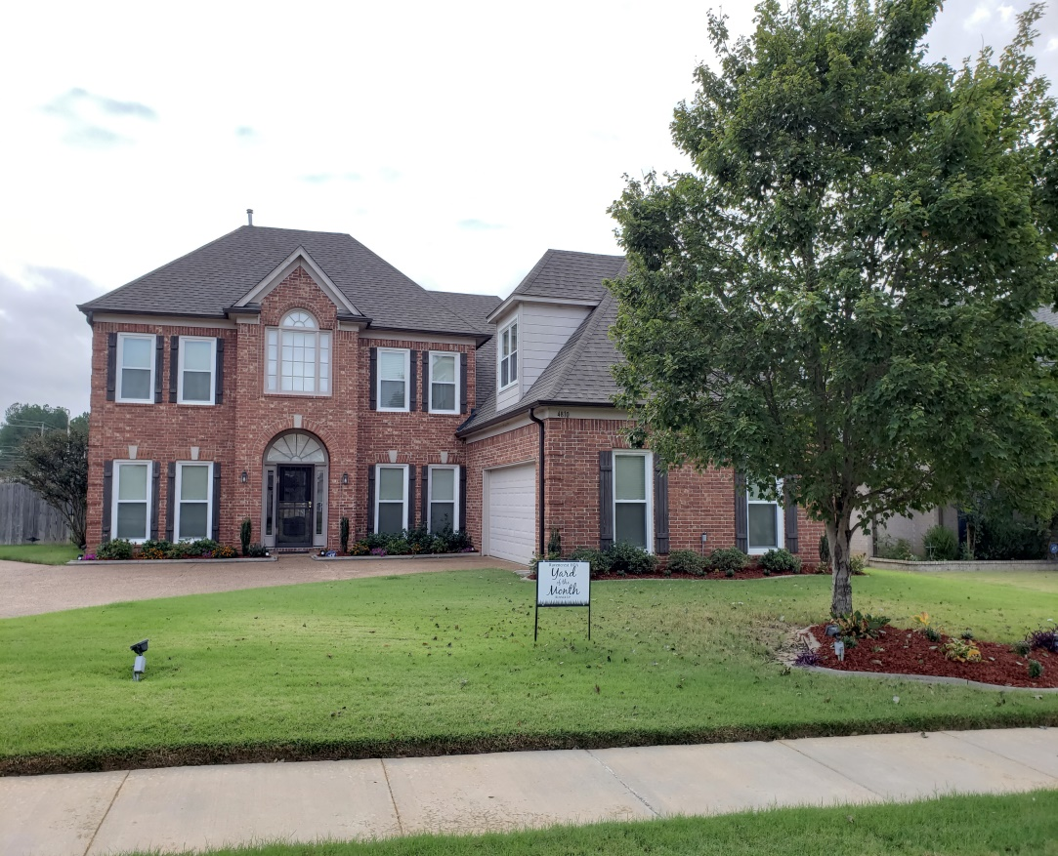
RHOA YOM Winners, September 2018!
YOM Runner Up:
Marilyn & Calvin Ridgell
.
4810 Sugarcrest Lane

Slide 3
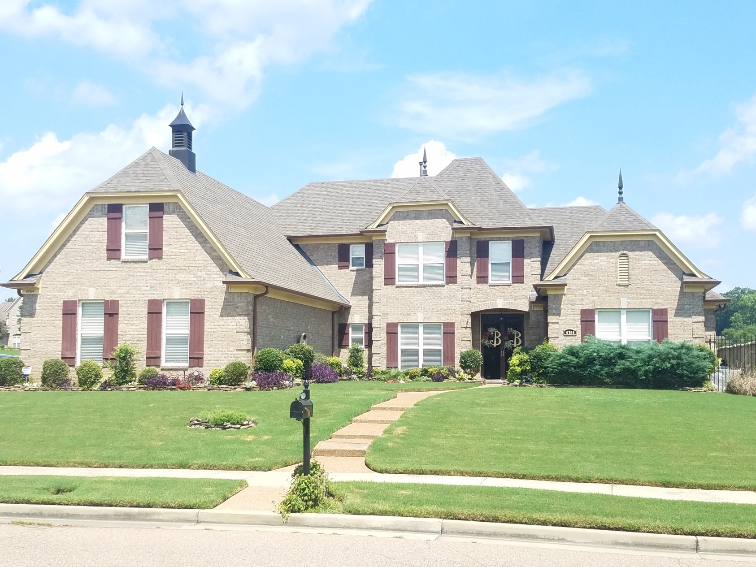
Honorable Mentions:
Morylann & Elijah Bernard, RHOA Architectural Committee Chair
4764 Dylan Valley Dr.

